Slide 1
Time series forecasting of energy generation data
By- Lokesh Kank

Slide 2
Objectives

Slide 3





Objective 1: To Analyze the past energy generation data to deduce a trend and predict the amount of energy that will be generated by the wind turbine generator by implementing Random Forest
Objective 2: Use the past data collected from the wind turbine generators to forecast the undesirable breakdowns due to various factors by using Random Forest

Slide 4



Objective 3: Combine and convert multiple data sets with different data formats to a single unified SQL database for the ease of analyzing and forecasting
Objective 4: Create an Energy Dashboard using Power BI to display the forecasted energy and break down data

Slide 5
Architecture

Slide 6
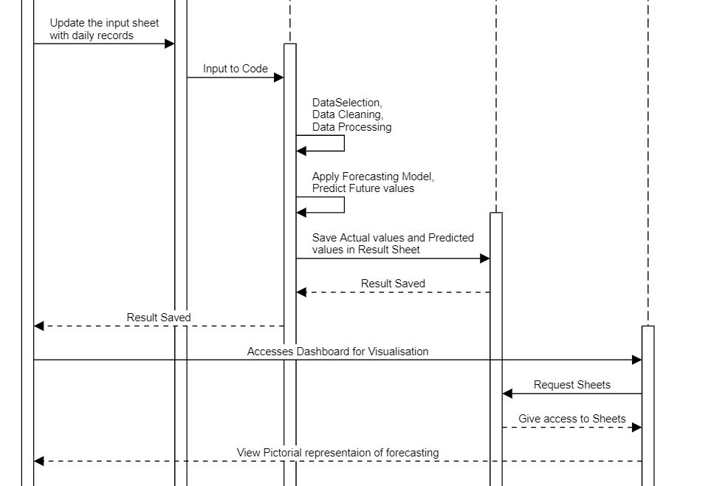
Engineer
Input Data Sheet
Python Code
Result Data Sheet
Dashboard

Slide 7
Random Forest
Regression predictive modelling with structured (tabular) data sets in excel spreadsheets
Fit, evaluate, and make predictions with an Random Forest regression model for time series forecasting

Slide 8
Extract needed columns from dataframe & fill ‘NA’ values & sort them
Set training data
Predict for the future dates we generated
1
3
5
STOP
2
4
6
Get all the next dates to predict & add it to dataframe
Fit the training data with Random Forest Regression Model
Save the values (probabilities) in result file

Slide 9
Test Cases
Check weather a file is present or not
Are there enough rows for prediction
(Caution!)

Slide 10
Objectives Achieved

Slide 11
01
Forecast energy generated
q)
02
Forecast breakdowns
03
Visual depiction of forecasts data
04
Data consolidation

Slide 12
Testing

Slide 13
1. Energy generation forecast accuracy: 42-85% approx. (varies according to location, weather and turbines)
2. Breakdown forecast Accuracy: 80-90% (varies according to factors and turbines)

Slide 14
Table of Summary

Slide 15
MERITS
It can decrease costs
Learning from past mistakes
Anticipate demand fluctuations more effectively.
DEMERITS
Any sudden unmeasured problem, leading to inconsistency in the pattern may occur. This means, the forecast cannot always be 100% accurate.
It can be time-consuming and resource-intensive

Slide 16
Future Scope

Slide 17
Future Scope
In future, fine tuning of the existing model with increased enhancement, increased input data will ameliorate the quality of the data model.

Slide 18
Thank You!

